Slide 1
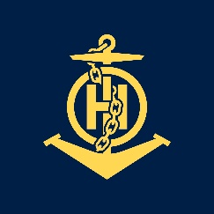
IHO – NIPPON FOUNDATION ALUMNI SEMINAR-2019 Singapore from 29 to 31 October 2019
IHO – NIPPON FOUNDATION
ALUMNI SEMINAR
Presented by:
Mr. Med ZABOUR
From the Algerian Naval Forces Hydrographic Office

Slide 2
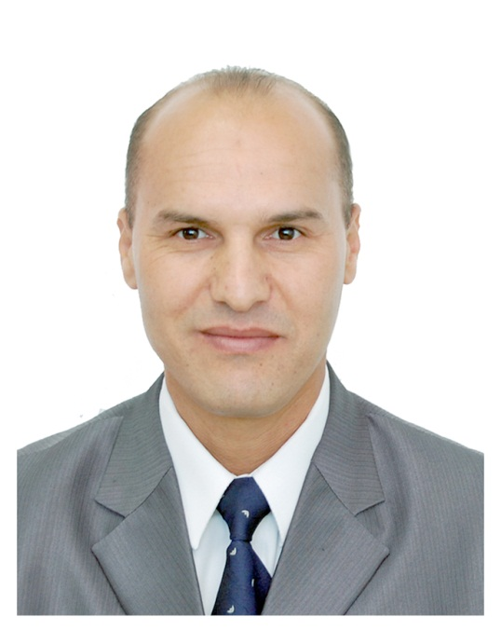
Self introduction
IHO – NIPPON FOUNDATION
ALUMNI SEMINAR
Name | Mohamed ZABOUR
Alumni year | 2013
Country | ALGERIA
Organization | Naval Forces Hydrographic Office
Position/Job title | Head of the Regional Hydrographic Office
Current job description | Responsible of all hydrographic and topographic works and data in the west of Algeria

Slide 3
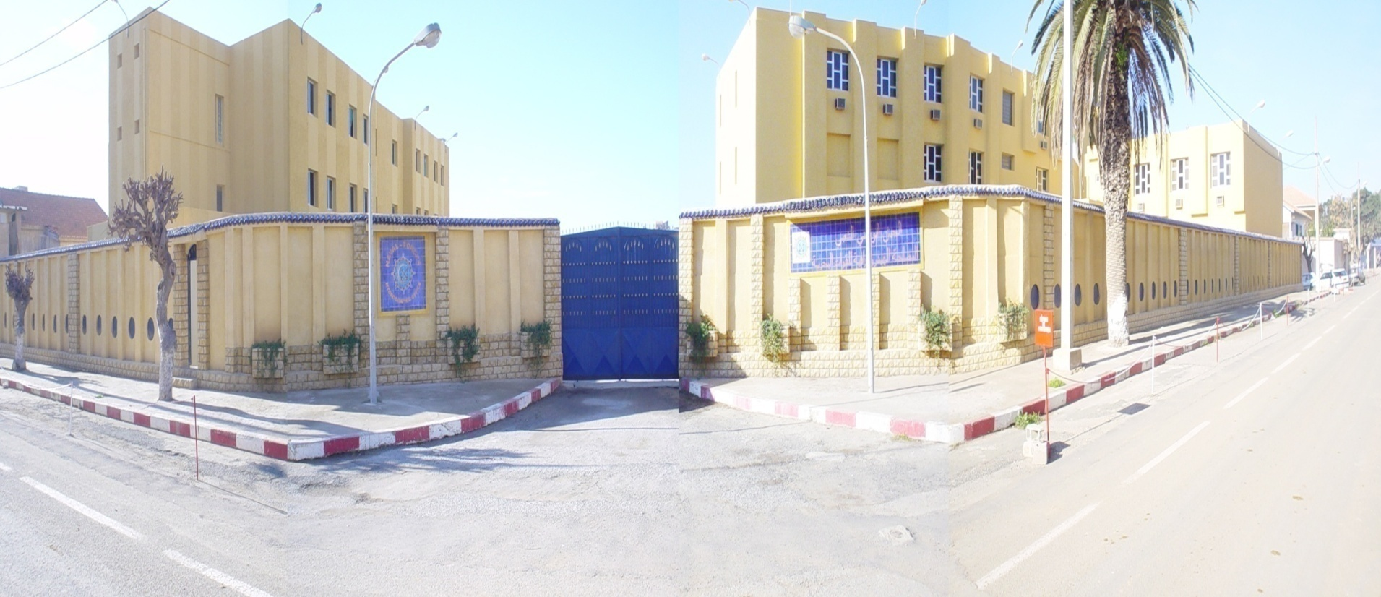
My career path and projects
IHO – NIPPON FOUNDATION
ALUMNI SEMINAR
I am working at the Hydrographic office since 2001, Actually before the course, as an engineer in topography works and geodesic sciences, my work consisted on ensuring survey and data process in topography, I had a little knowledge about Marine Cartography and Hydrography. By working years in the hydrographic office, I learned many things about the subject.

Slide 4
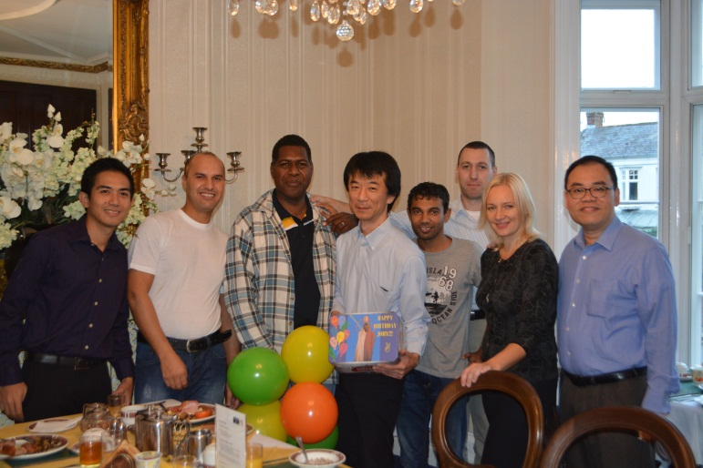
IHO – NIPPON FOUNDATION
ALUMNI SEMINAR
During the course
Once arrived to England, new life was started. Living alone in a hotel, far from my family and friends, a new environment, and new faces.

Slide 5
The first one was Marine Cartography which consisted on the basic procedures and steps to produce navigational charts in IHO standards. We studied many things in this module among them: chart symbols and abbreviations, chart text –type styles, navigational dangers, nature of seabed, topography and charts, depth unit and selection, depth contour, navigational aids, navigational lights, navigational buoys IALA.
IHO – NIPPON FOUNDATION
ALUMNI SEMINAR
For the course, as you know, was divided to three modules:

Slide 6
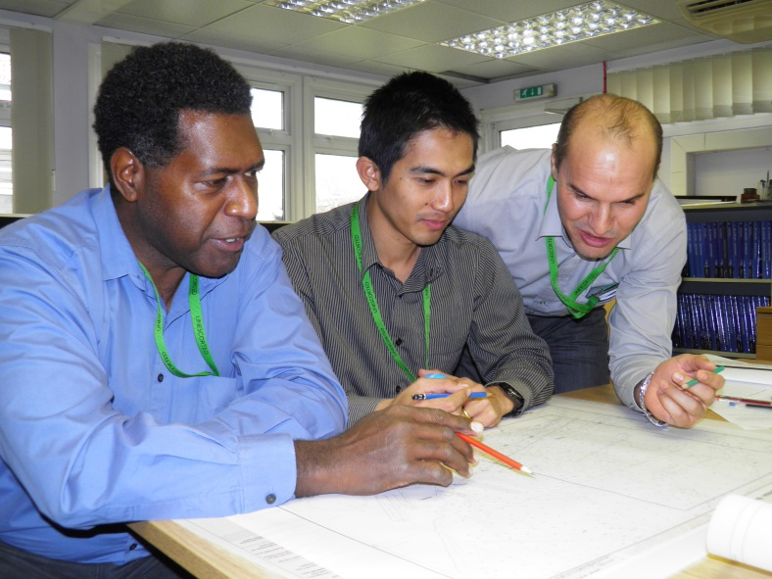
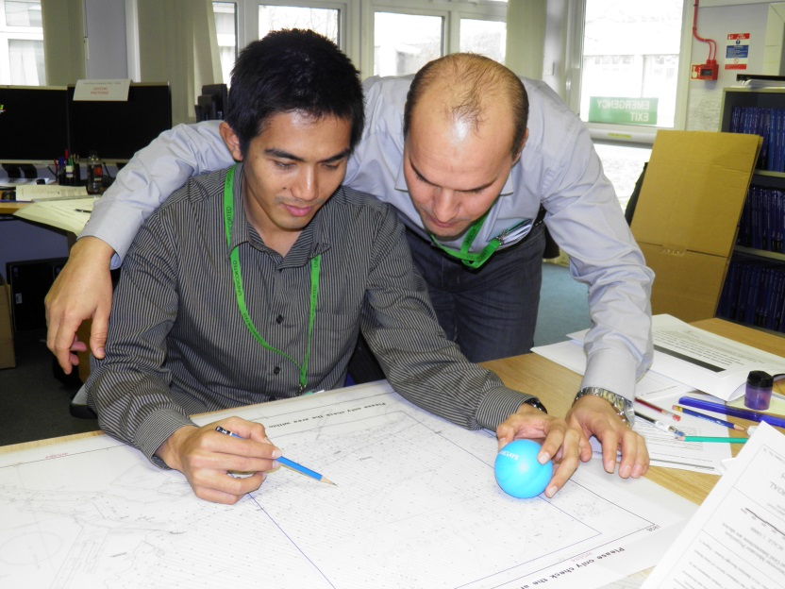
IHO – NIPPON FOUNDATION
ALUMNI SEMINAR
Cartographic exercises

Slide 7
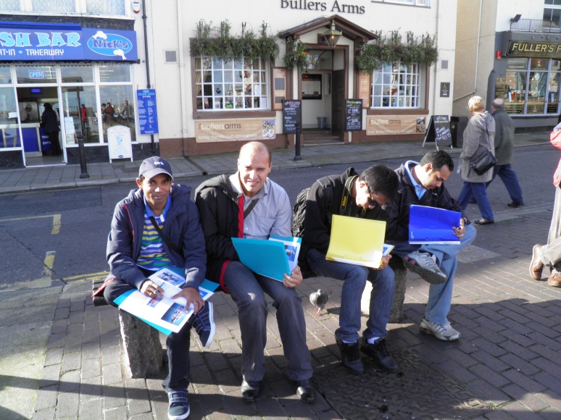
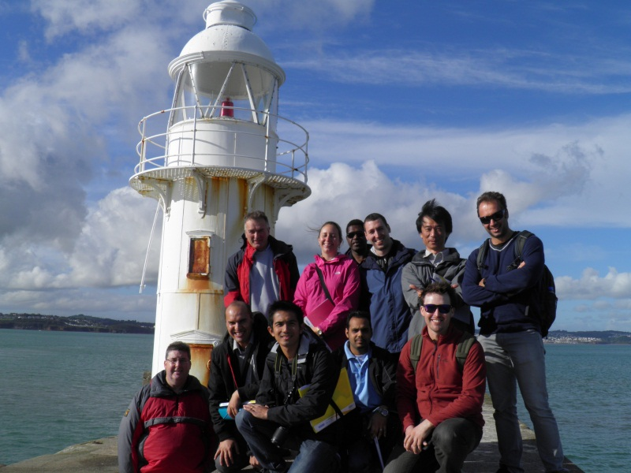
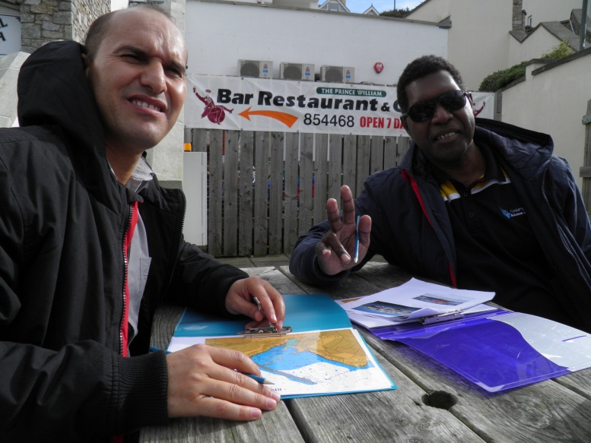
2. The second module was about Hydrographic Data Processing and the right way to produce different Notices to Mariners.
IHO – NIPPON FOUNDATION
ALUMNI SEMINAR

Slide 8
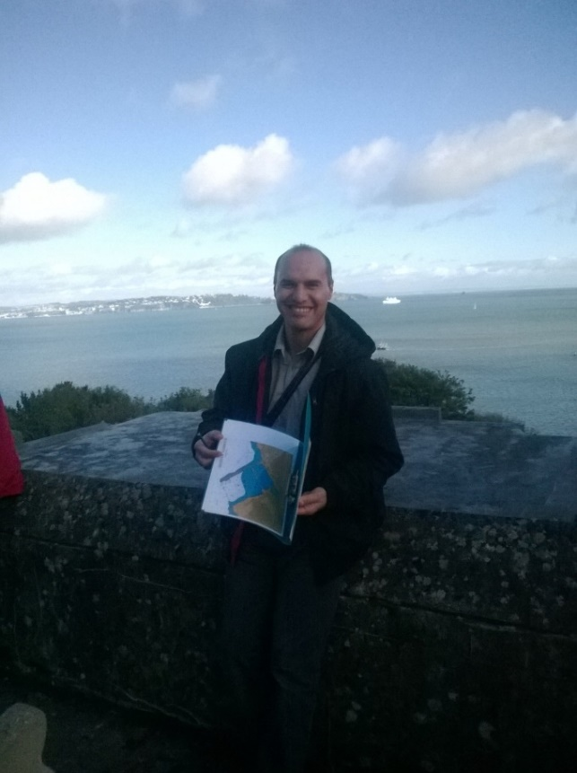
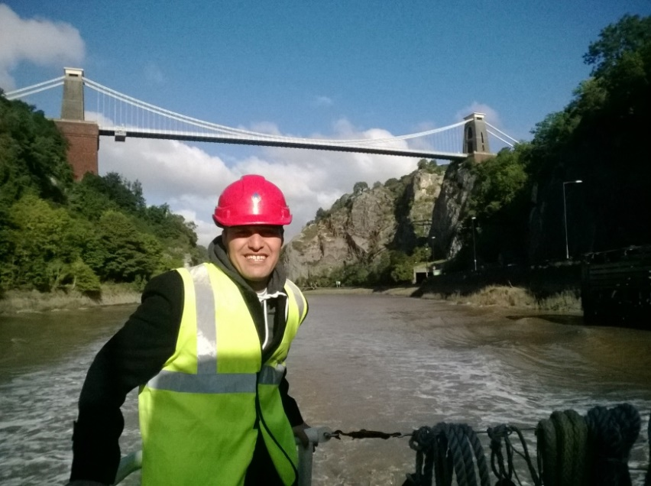
IHO – NIPPON FOUNDATION
ALUMNI SEMINAR
3. And the last one was Electronic Navigational Charts (ENC’s) which was about the production of the ENC’s in IHO standards and the correct way to control and validate them. I had the opportunity to work with Dkart, software which is used in my office. So It was easy for me, when I returned back home, to start directly working on ENCs.

Slide 9
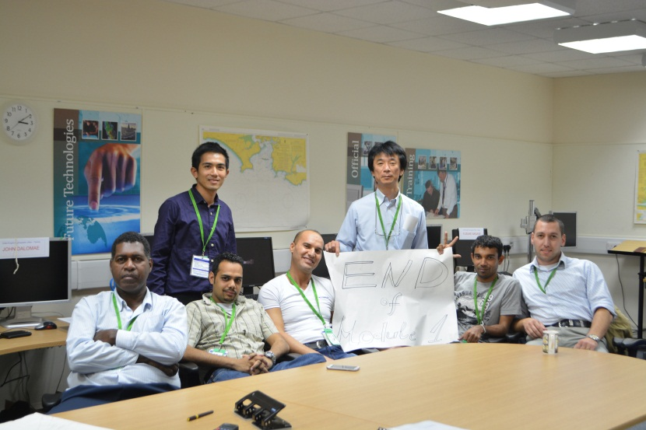
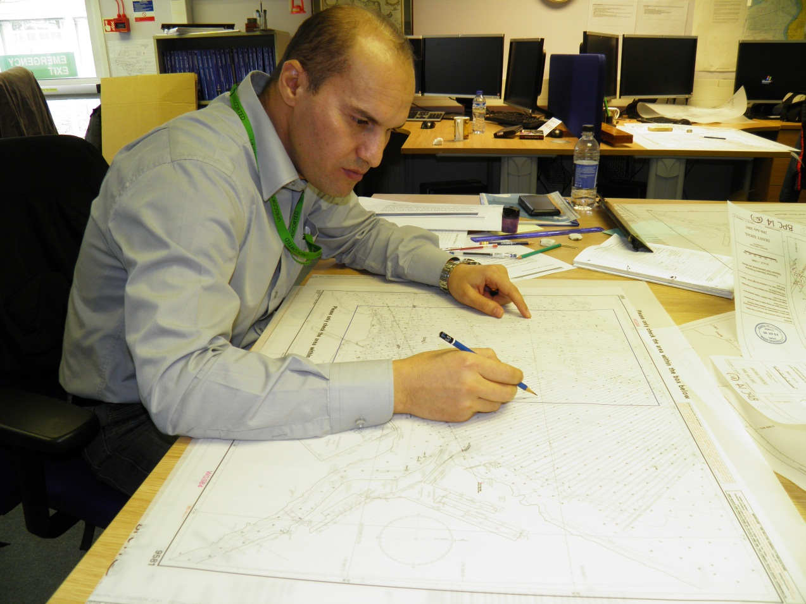
In each module many exercises were done, and too many exams. Every Friday, which was last day of the week, we had one exam to summarize what we studied over the week. A final exam of each module was done too.
IHO – NIPPON FOUNDATION
ALUMNI SEMINAR

Slide 10
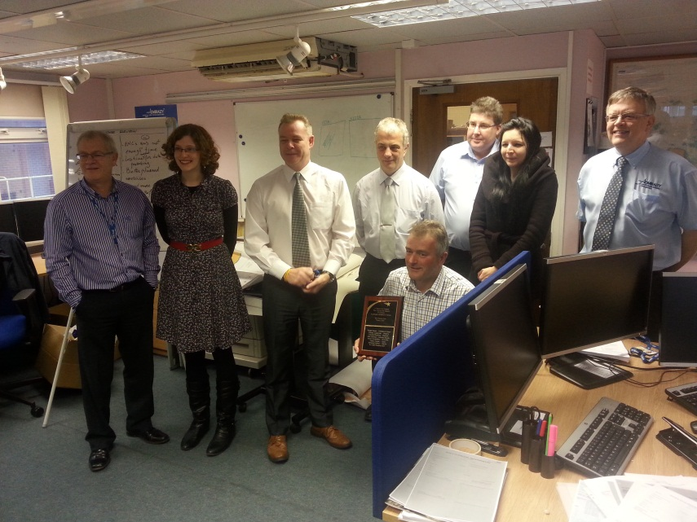
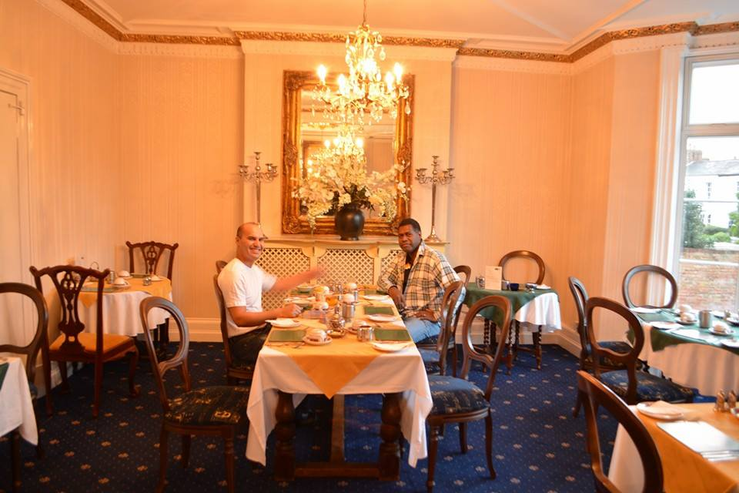
IHO – NIPPON FOUNDATION
ALUMNI SEMINAR
The course environment was perfect.
Very experiment, professional, very supportive and serious trainers, good accommodations, adequate means, serious trainees which allow me to gather maximum knowledge.

Slide 11
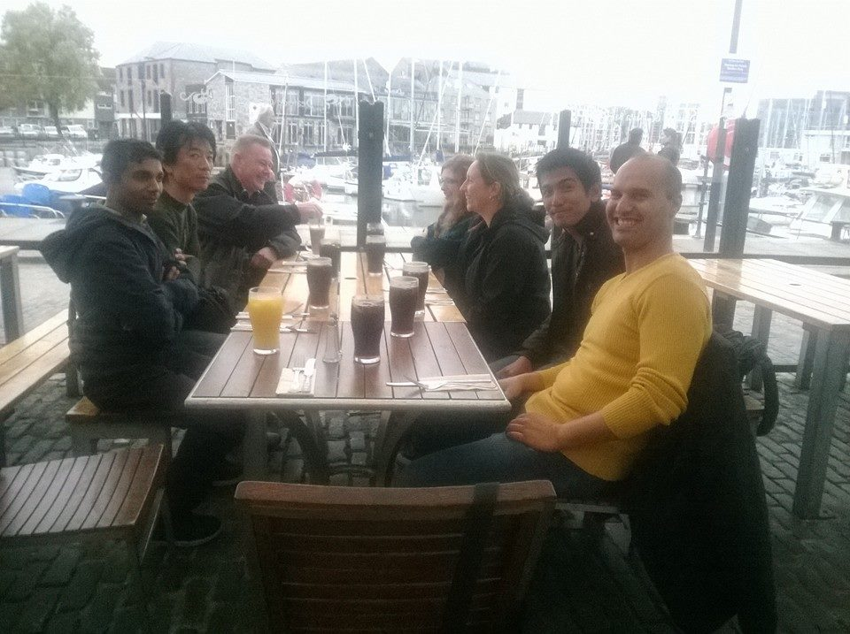
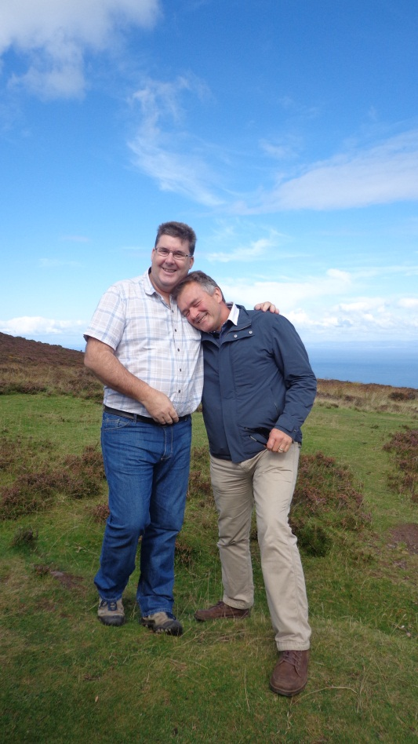
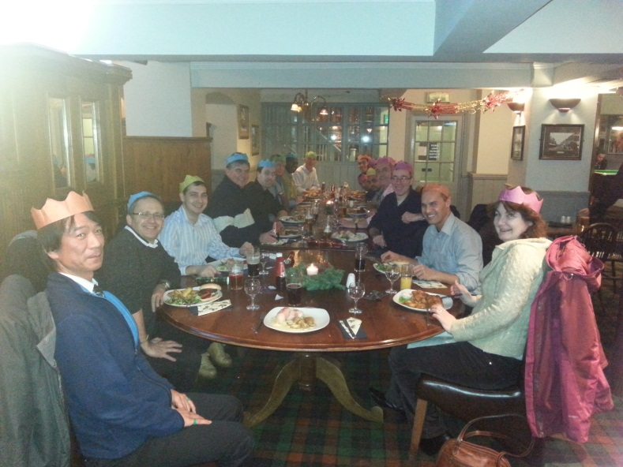
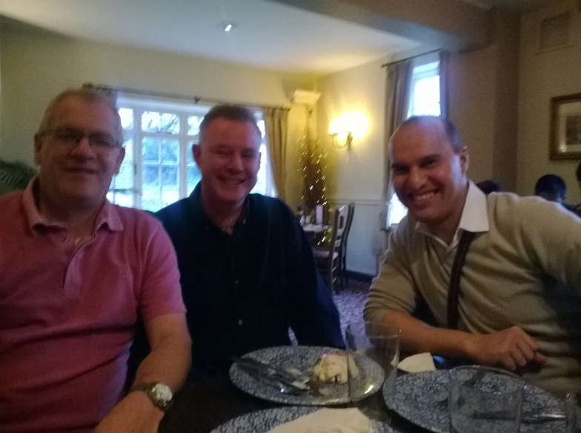
Very supportive and serious training staff
IHO – NIPPON FOUNDATION
ALUMNI SEMINAR

Slide 12
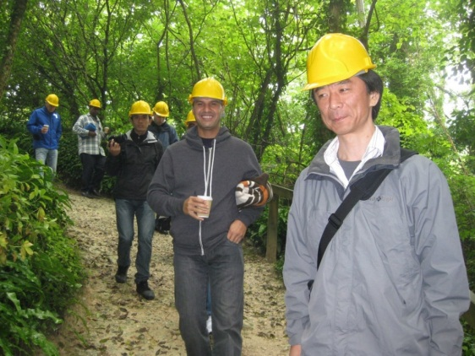
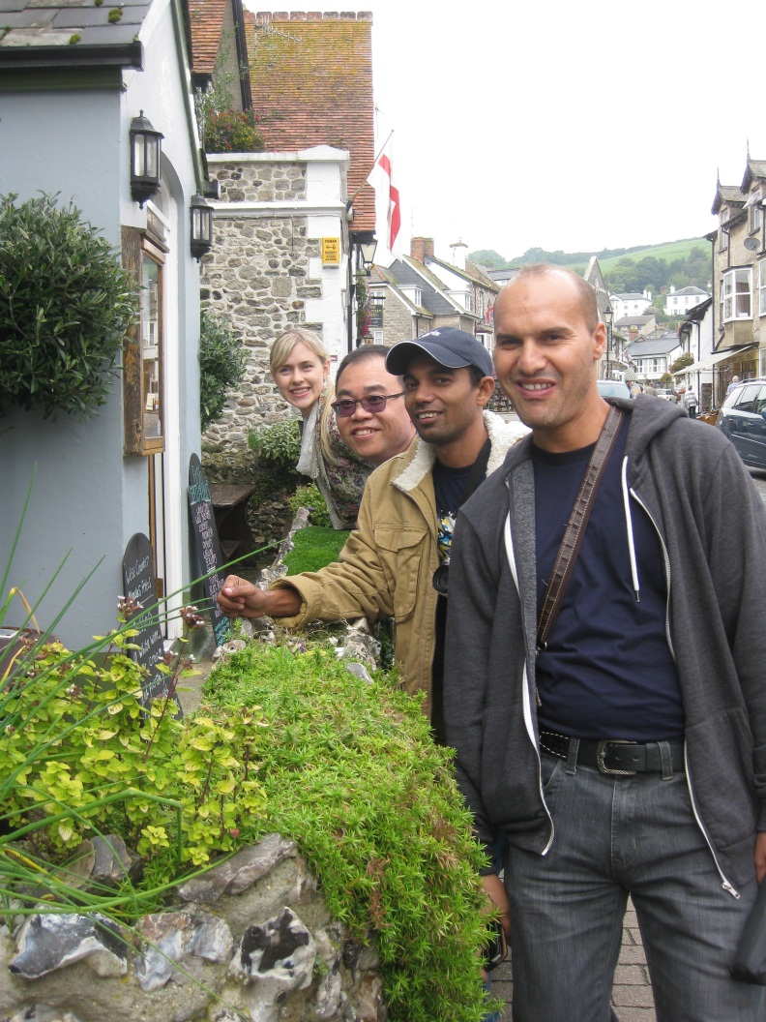
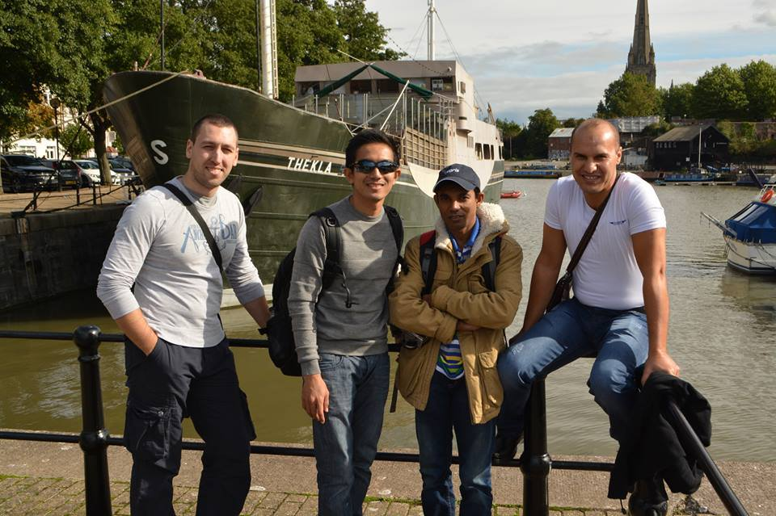
IHO – NIPPON FOUNDATION
ALUMNI SEMINAR
During the course, I had the chance to visit many places in UK, one Saturday of tow, a city or a village was be visited.

Slide 13
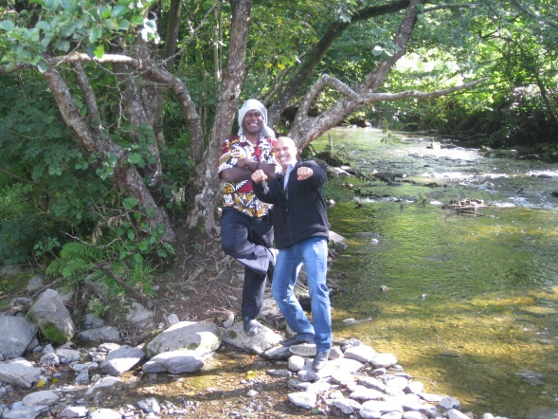
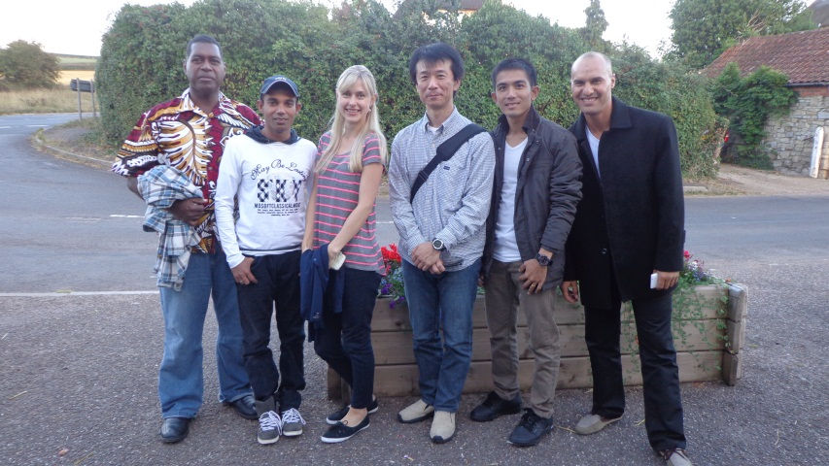
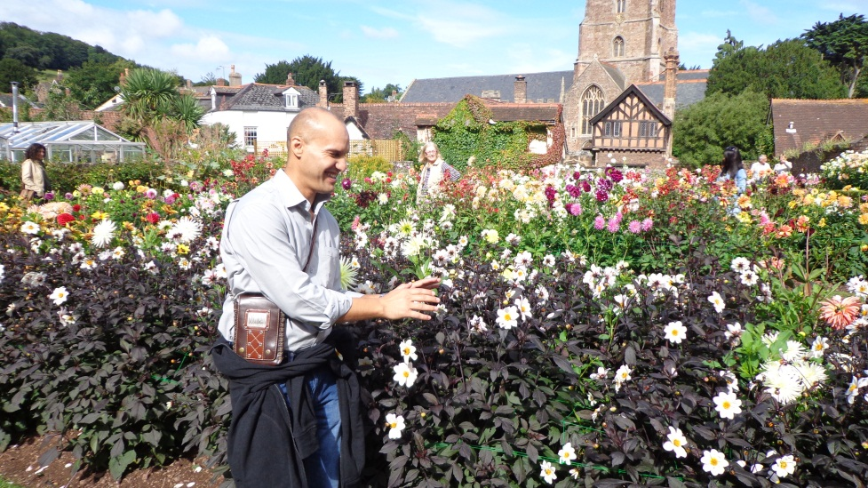
IHO – NIPPON FOUNDATION
ALUMNI SEMINAR

Slide 14
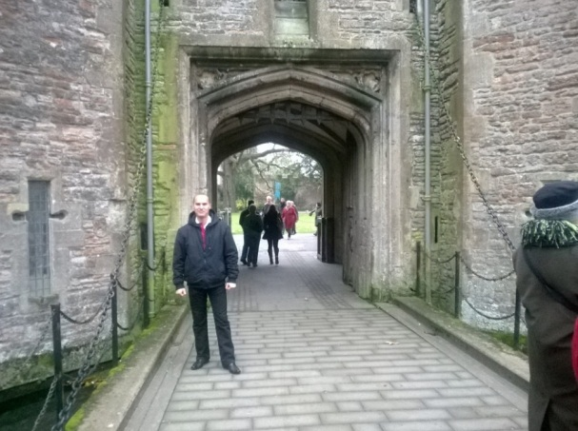
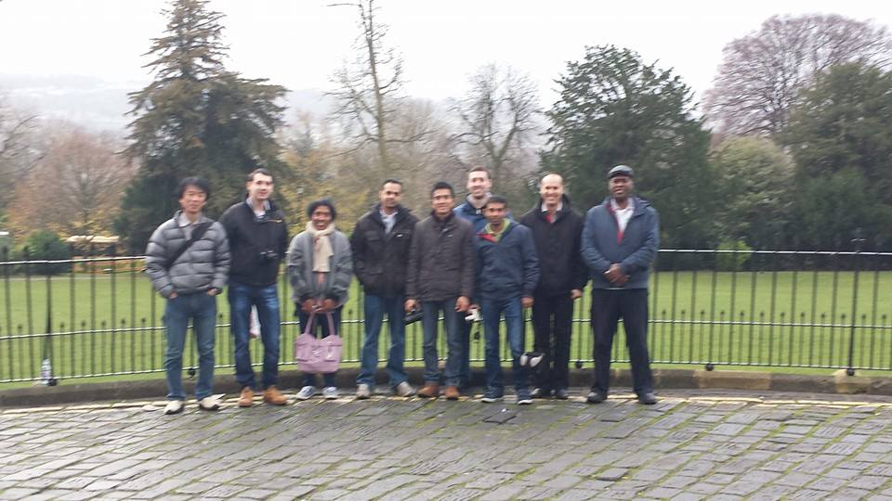
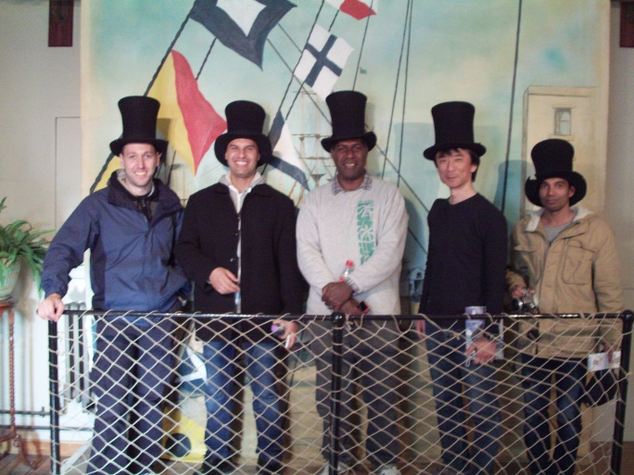
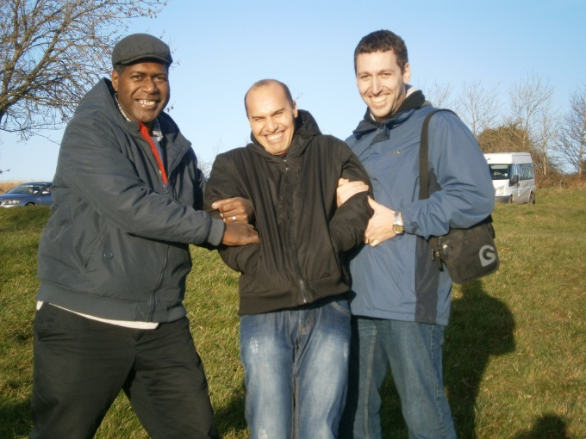
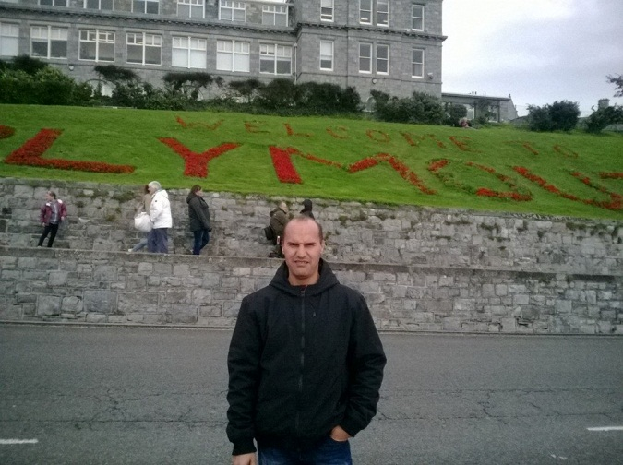
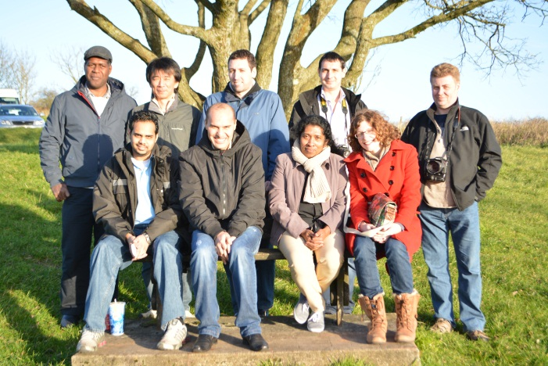
Many places, around the UK, were visited
IHO – NIPPON FOUNDATION
ALUMNI SEMINAR

Slide 15
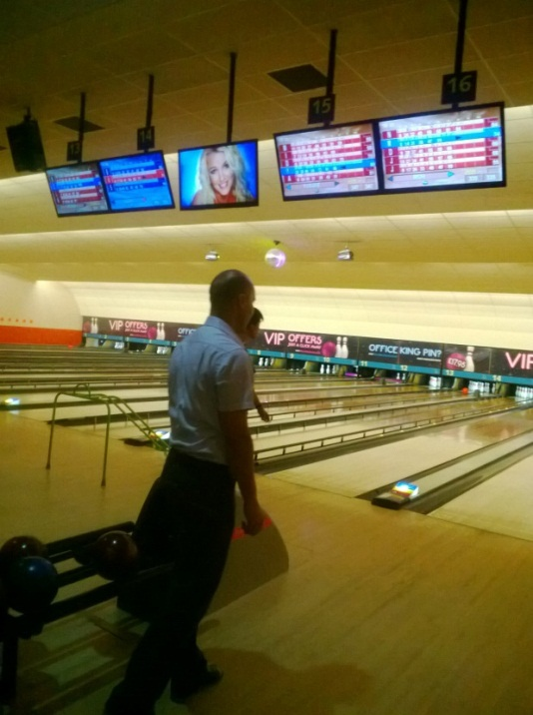
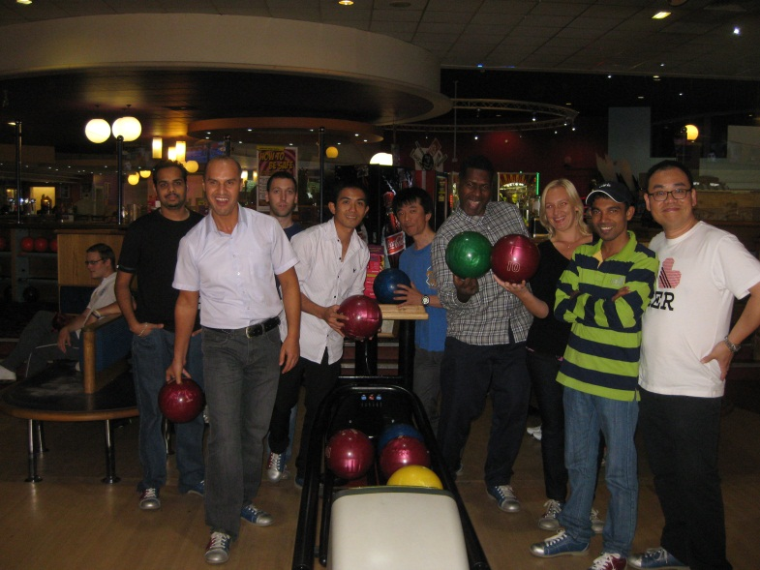
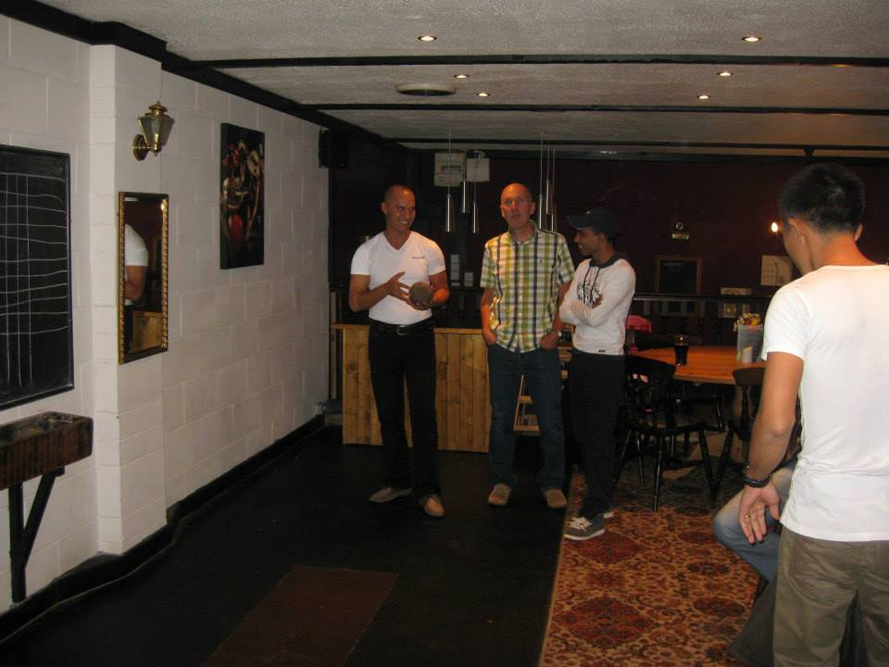
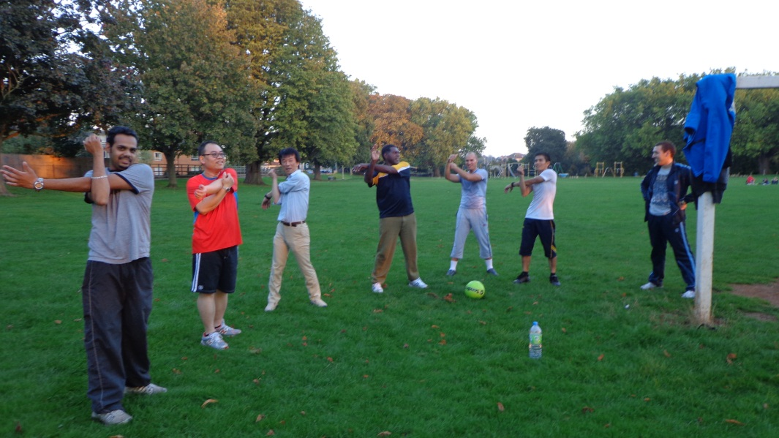
For not get bored of the course
IHO – NIPPON FOUNDATION
ALUMNI SEMINAR

Slide 16
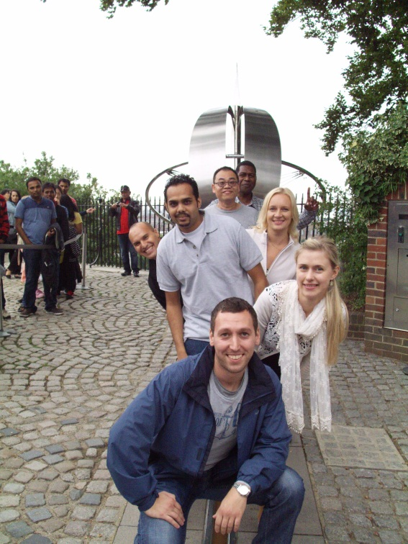
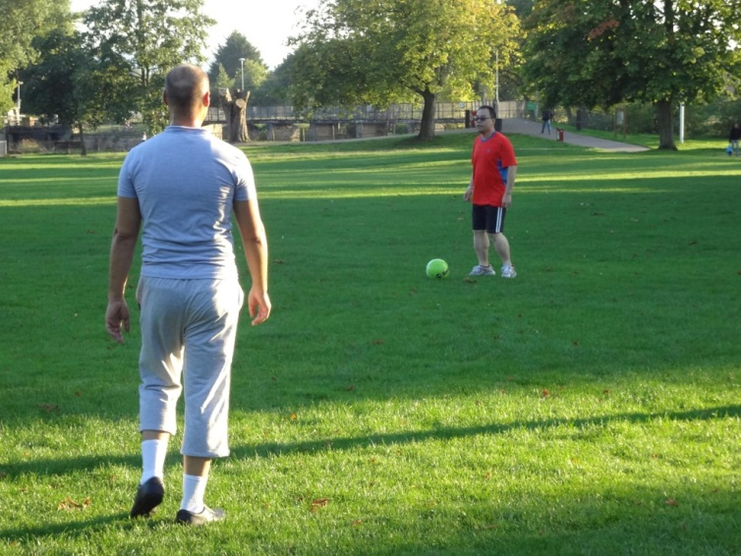
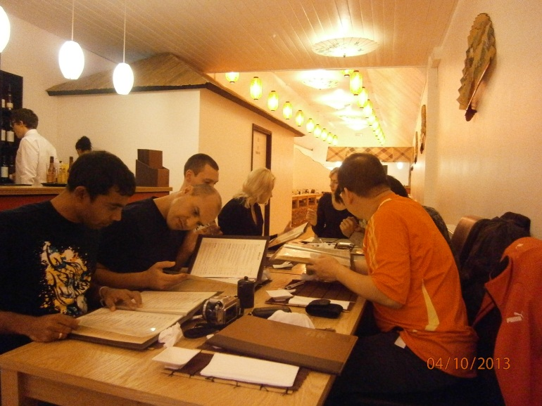
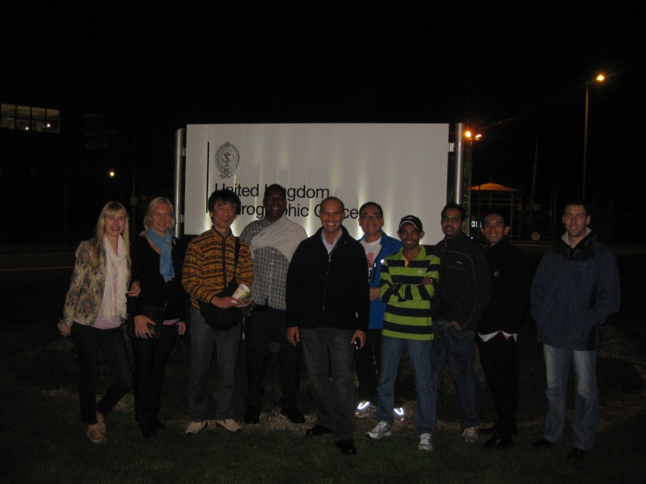
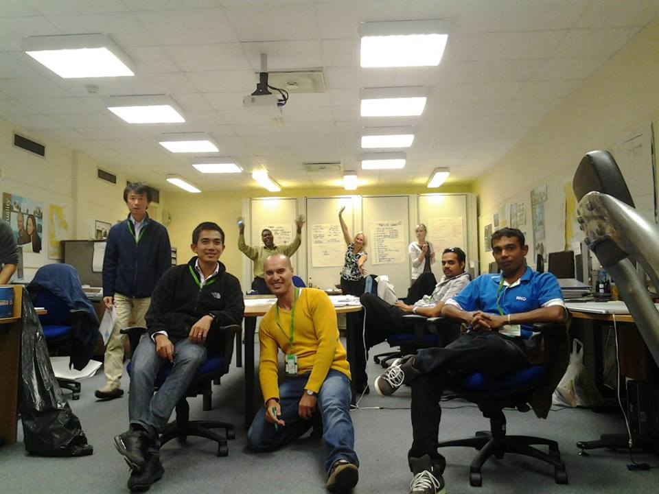
Just between trainees
Despite our different countries and cultures, we get used to live together easily as a family. We studied, practiced sports, lived and eat together.

Slide 17
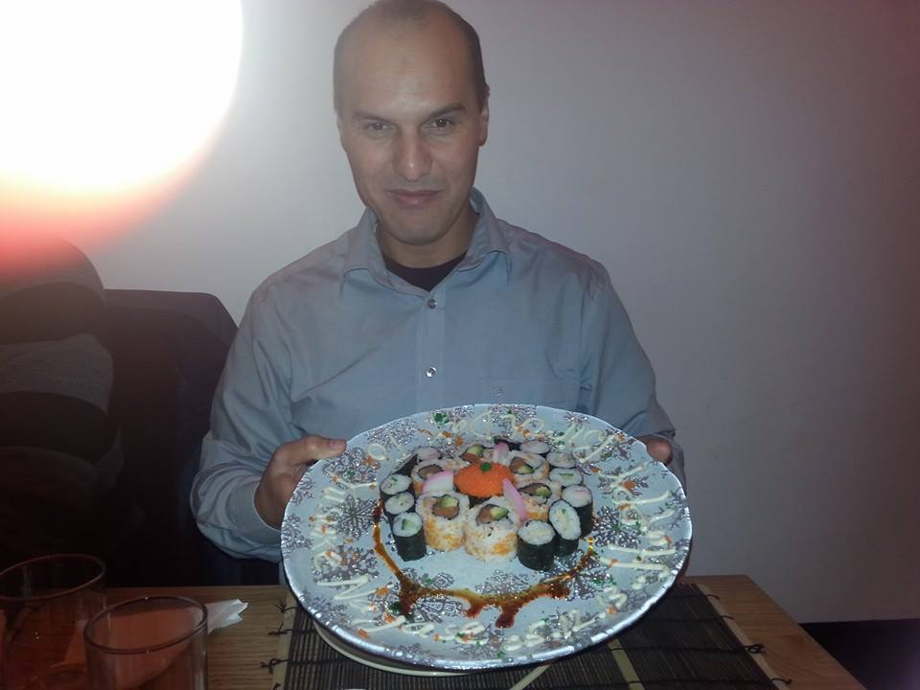
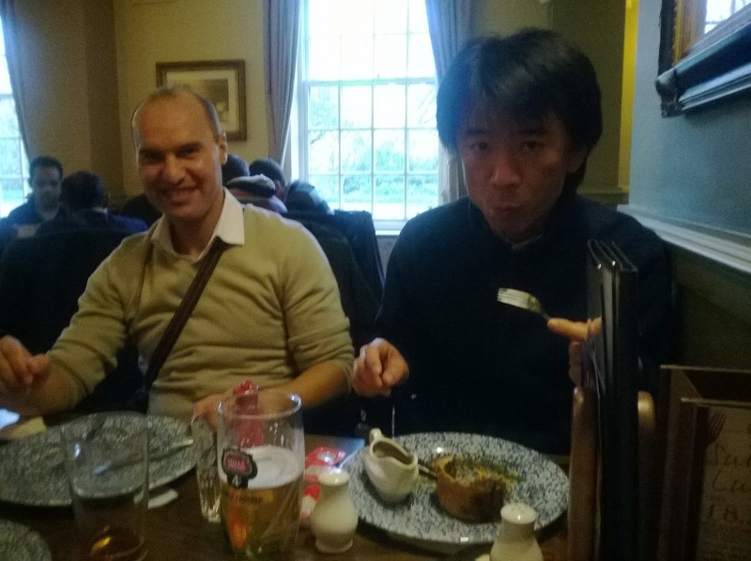
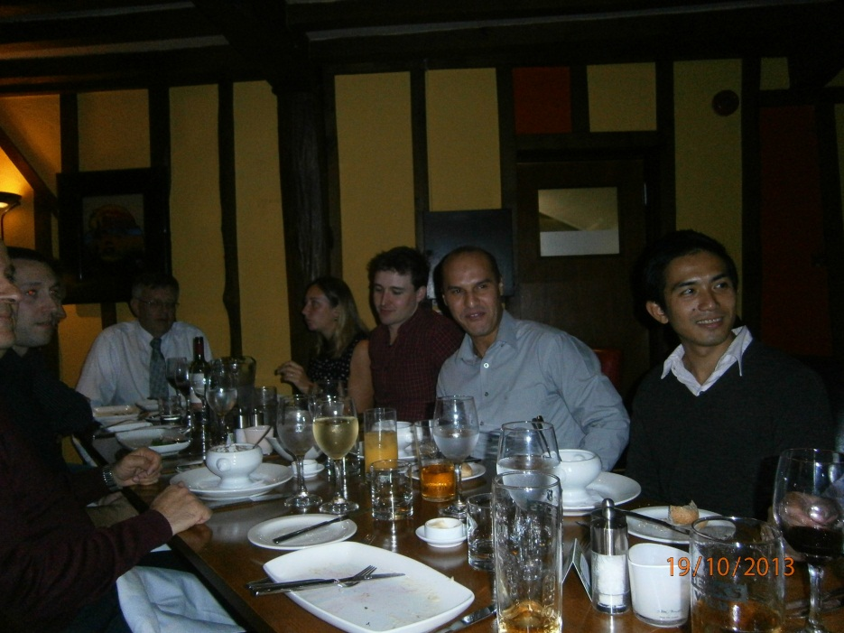
Taste different dishes

Slide 18
When I went back to the Algerian Hydrographic Office, and thanks to the course, many things have been changed to the better, especially in the procedures of establishing nautical charts and the processing of hydrographic data, it’s now going faster and more adequate to the IHO standards.
IHO – NIPPON FOUNDATION
ALUMNI SEMINAR
Lessons learned from CHART Course
Cartography training course gave me both – basics in theory and practical skills.

Slide 19
IHO – NIPPON FOUNDATION
ALUMNI SEMINAR
Now, I’m the head of the West Regional Hydrographic Service. I’m responsible of all hydrographic and topographic works in the west of Algeria.

Slide 20
Suggestion for the future
IHO – NIPPON FOUNDATION
ALUMNI SEMINAR
As recommendation, I hope that we will have the opportunity to get more course concerning the new revolution in cartographic and hydrographic data processing. And why not have course in CAT A in marine cartography and data processing.

Slide 21
IHO – NIPPON FOUNDATION ALUMNI SEMINAR-2019 Singapore from 29 to 31 October 2019
IHO – NIPPON FOUNDATION
ALUMNI SEMINAR
THANK YOU FOR YOUR ATTENTION
Presented by:
Mr. Med ZABOUR
From the Algerian Naval Forces Hydrographic Service

